Slide 1

Grocery Chain- FreshFare Markets Database System
Group 2
Omar Sakir
Fuad Hassan
Heron Ziegel
Tony Siu

Slide 2


Slide 3

Brief Overview

Slide 4

This is a database system for Fresh Fare Markets, a grocery store chain.
The relational database management system connects all the essential components that keep the business running smoothly.
The system facilitates the seamless integration of data across various entities such as Employees, Customers, Items, Orders, and Stores.
Entities are crafted with unique identifiers and attributes that correspond to the real-world aspects of the grocery business.

Slide 5
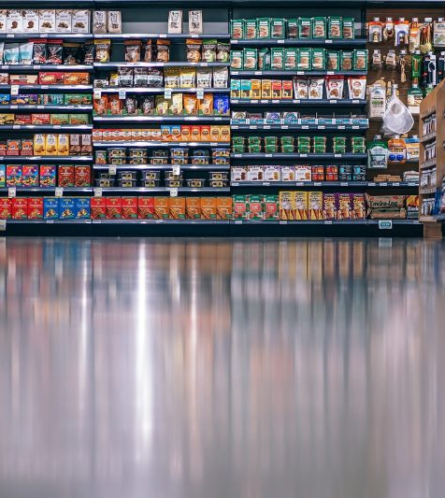
Use Cases
Order Processing::
Sales Tracking: Record and analyze sales data to understand purchasing trends and customer preferences.
Customer Profiles: Maintain detailed records of customers, including their purchasing history, preferences, and feedback to personalize the shopping experience.
Employee Records: Keep comprehensive records of employee details
Sales Reports: Generate detailed reports on sales, revenue
Store Performance: Evaluate and compare the performance of different store locations

Slide 6
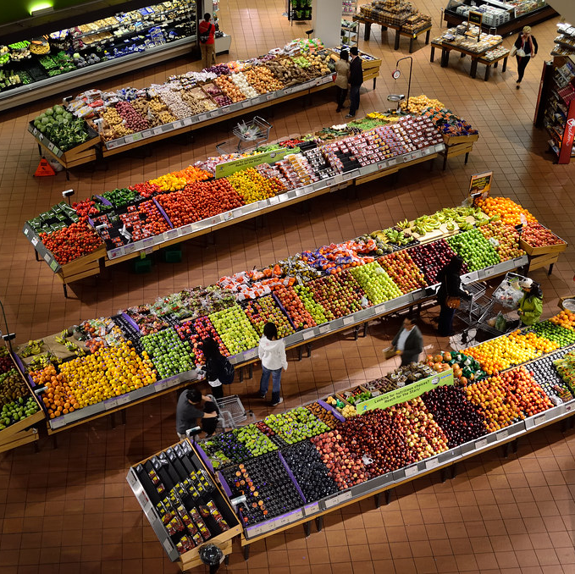
Entities
Employees
Customers
Items
Orders
Stores

Slide 7
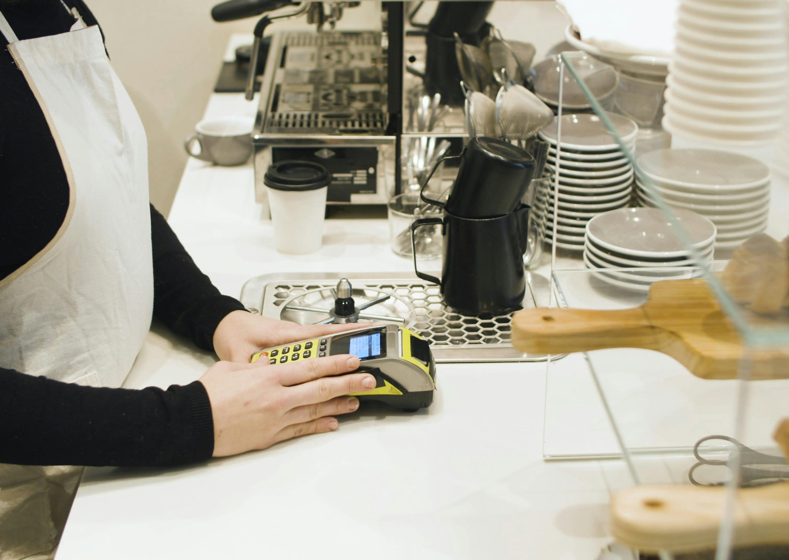
Employee Details
Attributes: EmployeeID (unique), FirstName, LastName
Relationship:
Each employee works at exactly one store.
Each employee can process multiple orders.

Slide 8

Customer Details
Attributes: CustomerID (unique), FirstName, LastName
Relationship:
Each customer can have multiple orders.
Each customer can visit many stores.

Slide 9
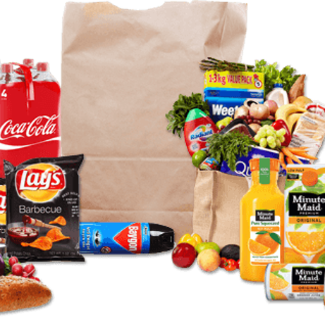
Item Details
Attributes: ItemID (unique), Price, Description
Relationship:
Can be included in multiple orders
This Photo by Unknown author is licensed under CC BY-NC.

Slide 10
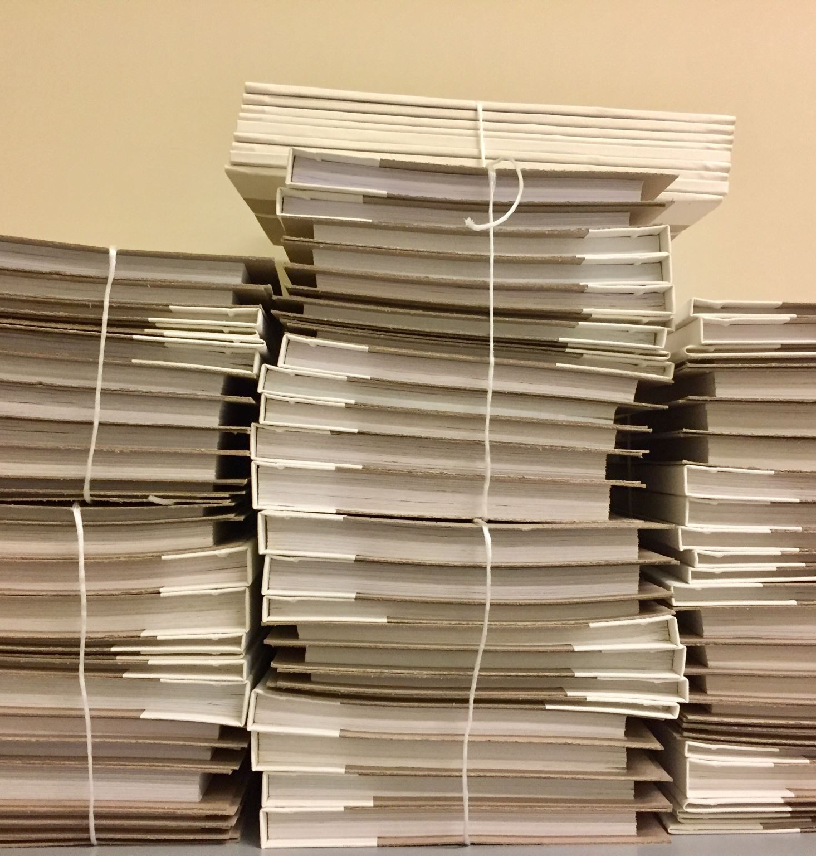
Order Details
Attributes: OrderID (unique), PurchaseDate, TimeCompleted, TotalPrice
Relationship:
Contains multiple items.
Belongs to one customer.
Processed by one employee.
Created at one store.

Slide 11

Store Details
Attributes: StoreID (unique), Address (Street, City, State, ZipCode)
Relationship:
Hosts multiple employees.
Can have multiple customers.
Can generate multiple orders.

Slide 12
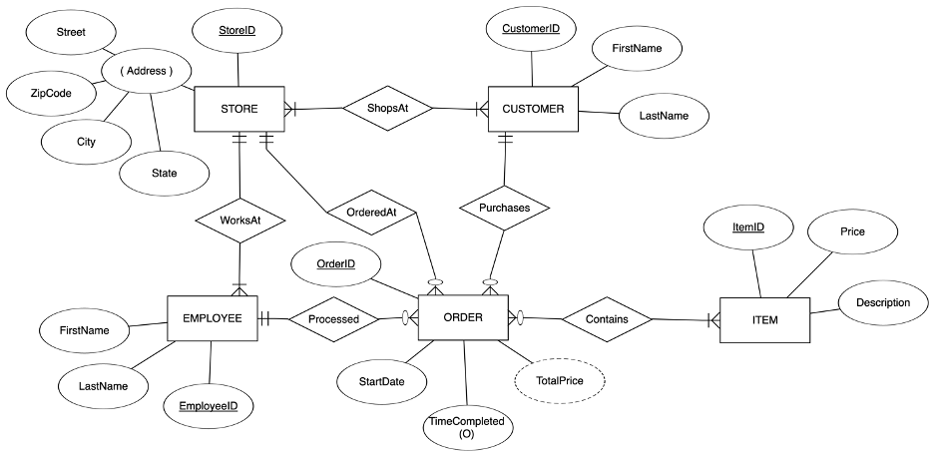
Entity Relation Diagram

Slide 13
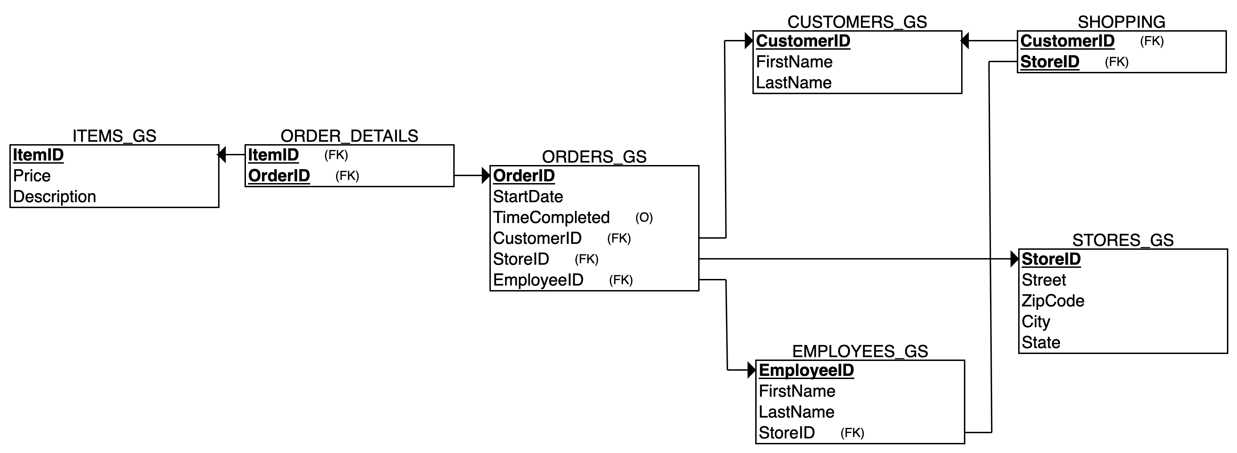
Relational Schema Design

Slide 14
Stores:
Each store is uniquely identified by StoreID and is characterized by its Address, which includes Street, City, State, and ZipCode.
Customers:
Customers are identified by CustomerID and have personal attributes like FirstName and LastName.
They have relationships indicating they ShopAt stores and make Purchases, linking to Orders.
Employees:
Identified by EmployeeID, with FirstName and LastName, each employee WorksAt one store.
Employees are linked to Orders they have Processed.
Each item has an ItemID, with a Description and Price.
Items are part of Orders through the Contains relationship.
Orders:
Orders are a central entity with OrderID, Start/OrderDate, optional TimeCompleted, and TotalPrice.
They have links to the Store where they were OrderedAt, the Customer who Purchases them, and the Employee who Processed them, as well as the Items they Contain.

Slide 15
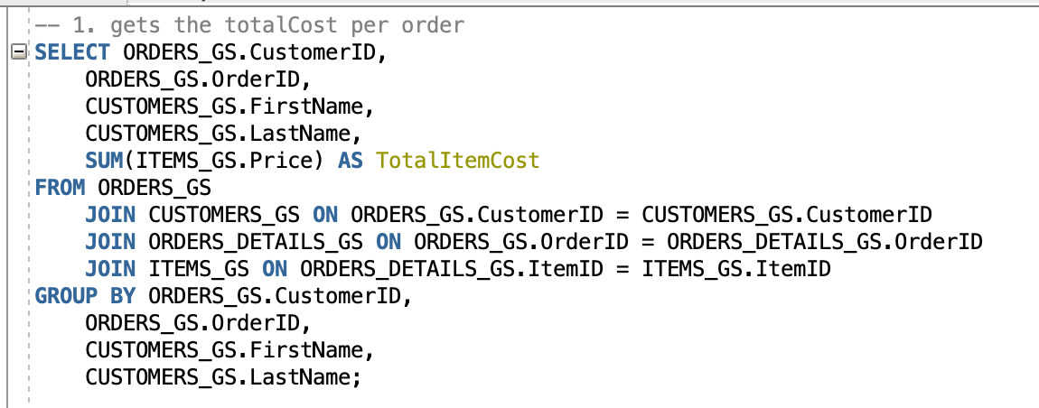
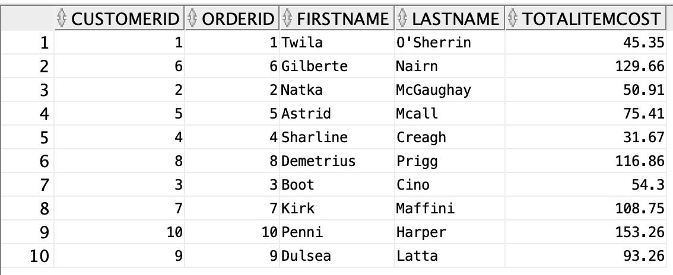
Use Case 1
Shows order data, including the generated column "Total Item Cost" and the customer's name

Slide 16
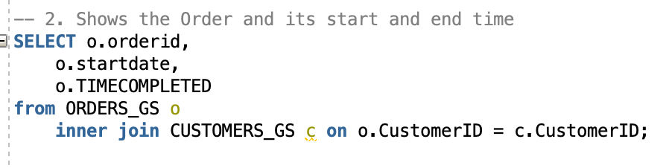
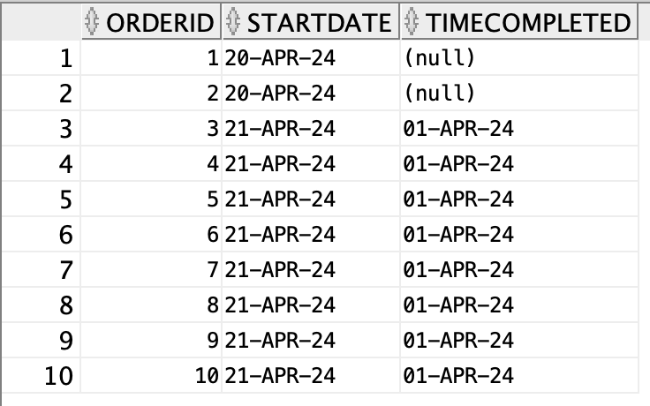
Use Case 2
Shows when orders were started and completed. If Time Completed contains a null value, the order is still being created.

Slide 17
Task | Name
Requirement | Heron, and 3 of us reviewed and edited
ERD | Heron, Fuad, Tony, Omar
Schema | We all did it together
SQL | Fuad, Omar, Tony
Presentation | Omar, and 3 of us
Summation and writing | Fuad

Slide 18

Thank you
Q&A

